Slide 1
Parallel Query Processing
R&G Chapters 22.1-22.4,

Slide 2
A little history
Relational revolution
declarative set-oriented primitives
1970’s
Parallel relational database systems
on commodity hardware
1980’s
Big Data: MapReduce, Spark, etc.
scaling to thousands of machines and beyond
2005-2015

Slide 3
Why Parallelism?
Scan 100TB
At 0.5 GB/sec (see lec 4): ~200,000 sec = ~2.31 days

Slide 4
Why Parallelism?
Scan 100TB
At 0.5 GB/sec (see lec 4): ~200,000 sec = ~2.31 days
Run it 100-way parallel:
2,000 sec = 33 minutes
1 big problem = many small problems
Trick: make them independent

Slide 5
Two Metrics to Shoot For
Speed-up
Increase HW
Fix workload
Scale-up
Increase HW
Increase workload
ideal
throughput
parallelism
throughput
ideal
data size + parallelism

Slide 6
Roughly 2 Kinds of Parallelism
Legend ⦁: running on machine 1
⦁: running on machine 2
⦁: running on machine 3
…
: any sequential program,
e.g. a relational operator
h(g(f(x₁)))
g(f(x₂))
f(x_{h(x)})
f(x₃)
Pipeline scales up to pipeline depth
Partition
scales up to amount of data
We’ll get more refined soon.

Slide 7
Easy for us to say!
Lots of Data:
Batch operations
Pre-existing divide-and-conquer algorithms
Natural pipelining
Declarative languages
Can adapt the parallelism strategy to the task and the hardware
All without changing the program!
Codd’s Physical Data Independence

Slide 8
DBs: The Parallel Boy that Lived
1980s CS challenge: “parallelize” software
E.g. via awesome new C compilers
E.g. via variants of C designed for parallelism
In broad terms, a failure
Dave Patterson: The “Dead Computer Society”
Exception: Parallel SQL Databases
Why? Data Independence!
SQL is independent of how many machines you have!
The same divide-and-conquer that worked for disks works across machines, as we’ll see
Big Data is the generalization of these lessons
Or in some cases a re-learning of them
This slide is FYI; will not be on exam

Slide 9
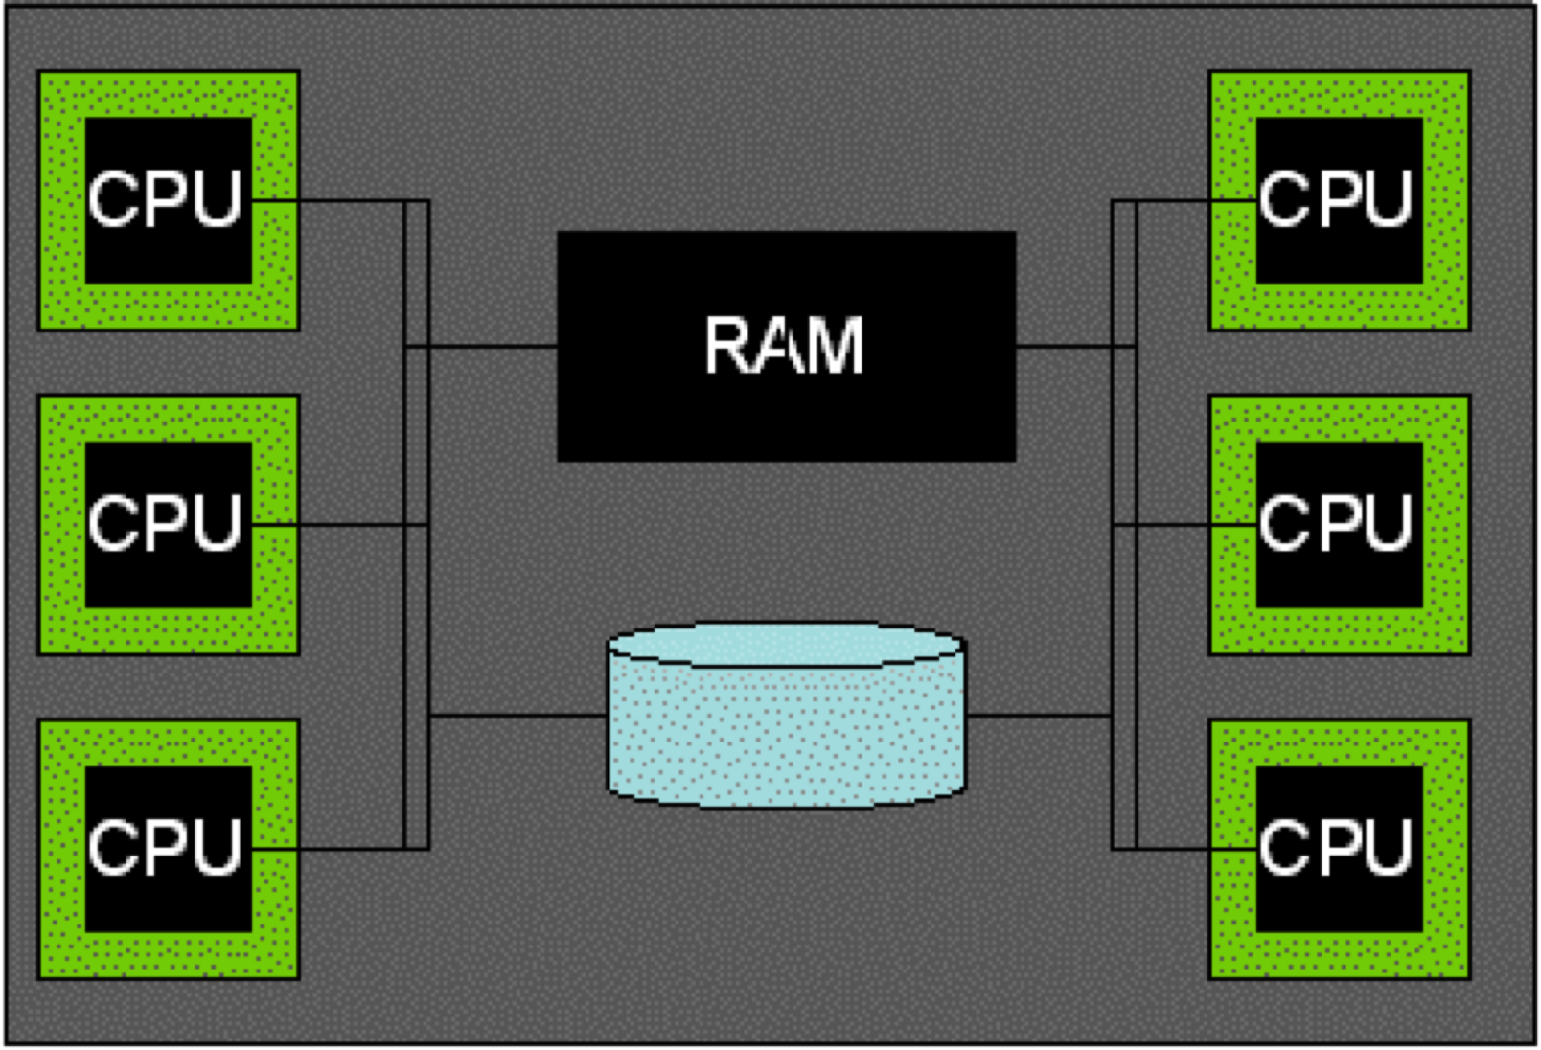
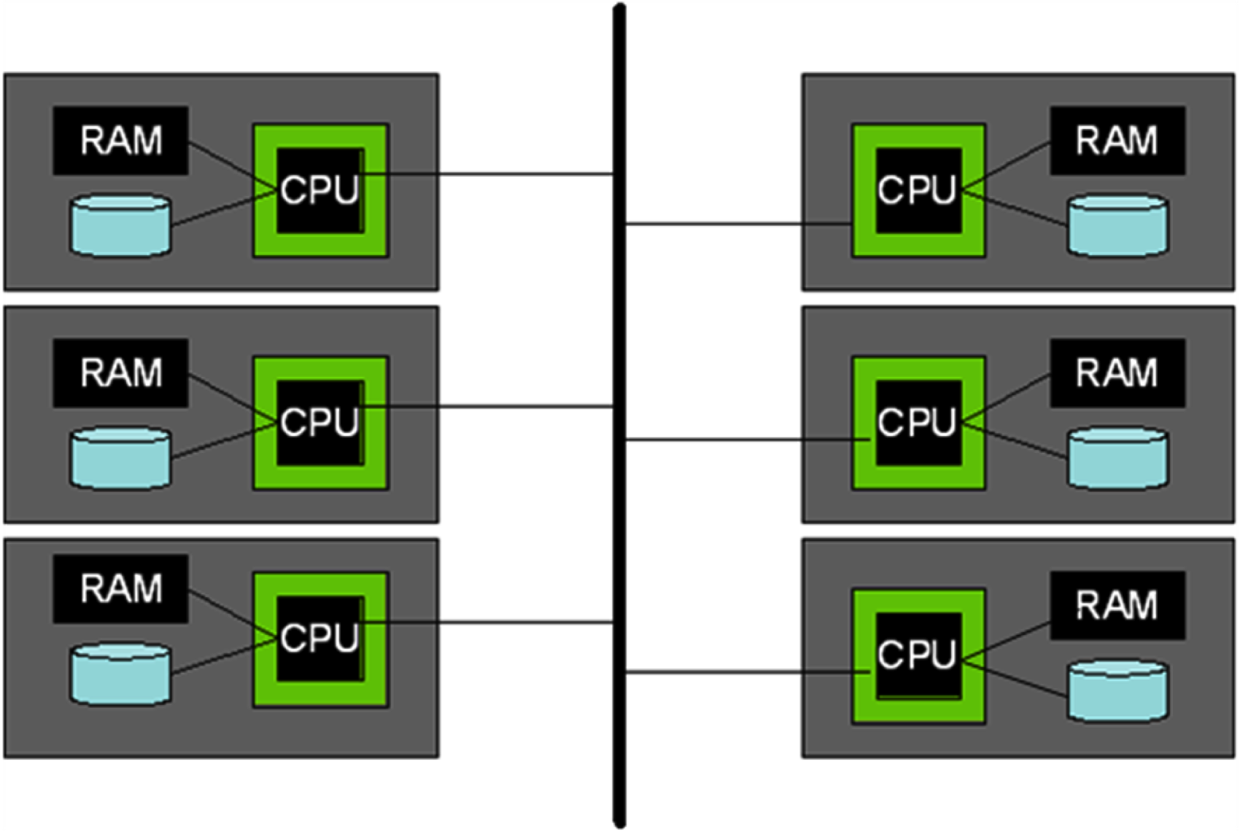
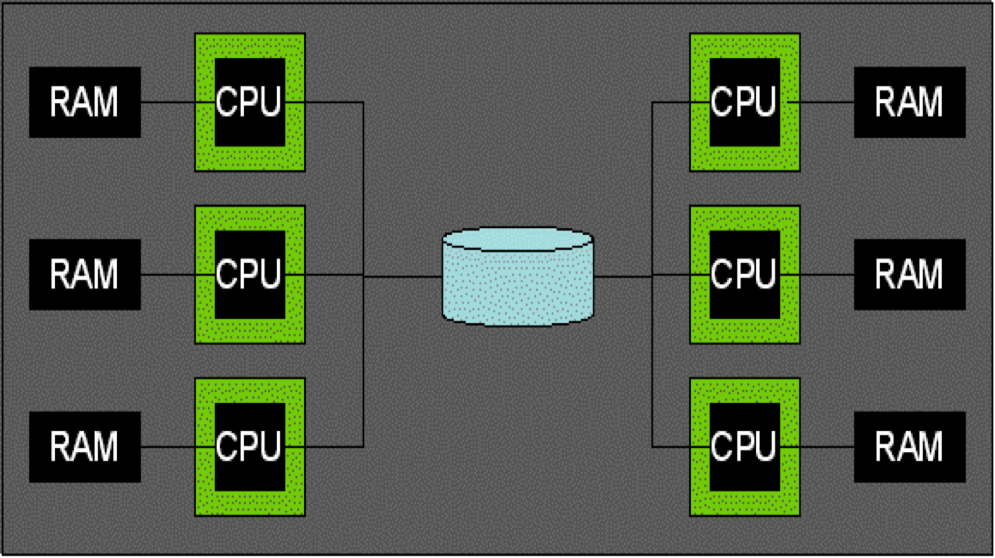
Parallel Architectures
Shared Memory
Shared Disk
Shared Nothing (cluster)

Slide 10
Some Early Systems
Research
XPRS (Berkeley, shared-memory)
Gamma (Wisconsin, shared-nothing)
Volcano (Colorado, shared-nothing)
Bubba (MCC, shared-nothing)
Grace (U. Tokyo, shared-nothing)
Industry
Teradata (shared-nothing)
Tandem Non-Stop SQL (shared-nothing)
This slide is FYI; will not be on exams

Slide 11
What about the cloud?
See hidden slides
Upshot: not so different from what we’ll see here
Hopefully a guest lecture later in semester to talk about what is different

Slide 12
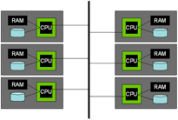
What about the cloud?
Can treat it as shared nothing
This slide is FYI; will not be on exams

Slide 13
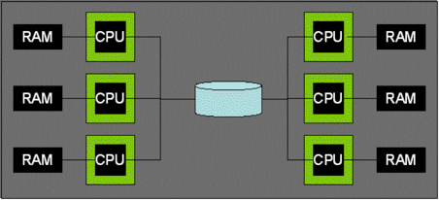
What about the cloud?
Can treat it as shared nothing
Can also treat it as shared disk, e.g. AWS Simple Storage Service (S3)
Though most shared cloud storage systems don’t allow update-in-place today
S3
This slide is FYI; will not be on exams

Slide 14
What about the cloud?
Can treat it as shared nothing
Can also treat it as shared disk, e.g. AWS Simple Storage Service (S3)
Though most shared cloud storage systems don’t allow update-in-place today
Shared memory?
You can rent a shared memory box up to some size
This slide is FYI; will not be on exams

Slide 15
What about the cloud?
Can treat it as shared nothing
Can also treat it as shared disk, e.g. AWS Simple Storage Service (S3)
Though most shared cloud storage systems don’t allow update-in-place today
Shared memory?
You can rent a shared memory box up to some size
Beyond that it’s NUMA: Non-Uniform Memory Access
This is a pain to do well
A mix of shared-nothing and shared memory
A fate that awaits all SW?
This slide is FYI; will not be on exams

Slide 16
Shared Nothing
We will focus on Shared Nothing here
It’s the most common
DBMS, web search, big data, machine learning, …
Runs on commodity hardware
Scales up with data
Just keep putting machines on the network!
Does not rely on HW to solve problems
Good for helping us understand what’s going on and control it in SW

Slide 17
Quick Check
Match the metric to the ideal curve:
Speed-up
Scale-up
Which has more scaling potential
Pipeline parallelism
Partition parallelism
Which architectures allow all CPUs to access the same disk
Shared memory B. Shared disk
Shared nothing D. none of the above
T/F: Adding another machine to a parallel cluster offers only a constant factor performance benefit
1
2

Slide 18
Kinds of Query Parallelism
Inter-query (parallelism across queries)
Each query runs on a separate processor
Single thread (no parallelism) per query
Does require parallel-aware concurrency control
A topic for later in the semester
SQL
SQL
Note on latin prefixes
inter: “between”, “across”. Korea tested an intercontinental missile
intra: “within”. The political party suffered from intraparty rivalries.
SQL
SQL
SQL
DBMS

Slide 19
Kinds of Query Parallelism
Intra-query (within a single query)
Inter-operator (between operators)
“Logical” Plan
h(g(f(x₁)))
g(f(x₂))
f(x₃)

Slide 20
Kinds of Query Parallelism
Legend ⦁: running on machine 1
⦁: running on machine 2
⦁: running on machine 3
Intra-query
Inter-operator
“Logical” Plan
h(g(f(x₁)))
g(f(x₂))
h(g(f(x₁)))
f(x₃)
g(f(x₂))
f(x₃)
Pipeline Parallelism

Slide 21
Kinds of Query Parallelism
Legend ⦁: running on machine 1
⦁: running on machine 2
⦁: running on machine 3
Intra-query
Inter-operator
“Logical” Plan
⨝
⨝
⨝
“Logical” Plan
h(g(f(x₁)))
Scan R
Scan S
Scan T
Scan U
g(f(x₂))
h(g(f(x₁)))
f(x₃)
g(f(x₂))
f(x₃)
Pipeline Parallelism

Slide 22
Kinds of Query Parallelism
Legend ⦁: running on machine 1
⦁: running on machine 2
⦁: running on machine 3
Intra-query
Inter-operator
“Logical” Plan
⨝
⨝
⨝
“Logical” Plan
h(g(f(x₁)))
Scan R
Scan S
Scan T
Scan U
g(f(x₂))
h(g(f(x₁)))
⨝
g(f(x₂))
mat
mat
f(x₃)
⨝
⨝
f(x₃)
Scan R
Scan S
Scan T
Scan U
Pipeline Parallelism
Bushy (Tree) Parallelism

Slide 23
Kinds of Query Parallelism
Intra-query
Intra-operator (within a single operator)
“Logical” Plan
⨝
Scan R
Scan S

Slide 24
Kinds of Query Parallelism
Legend ⦁: running on machine 1
⦁: running on machine 2
⦁: running on machine 3
Intra-query
Intra-operator
“Logical” Plan
⨝
Scan R
Scan S
⨝
⨝
⨝
Scan R
Scan S
Scan R
Scan S
Scan R
Scan S
Partition Parallelism

Slide 25
Summary: Kinds of Parallelism
Inter-Query
Intra-Query
Inter-Operator
Intra-Operator (partitioned)
pipeline
bushy

Slide 26
Quick Check
Match the term and definition:
Intra-operator
Inter-operator
Match the general category with the kind of intra-query parallelism
Intra-operator
Inter-operator
Within an operator
Across operators
Partition parallel
Bushy parallel
Pipeline parallel

Slide 27
Intra-Operator Parallelism i
Scans and Selections

Slide 28
Data Partitioning
How to partition a table across disks/machines
Range Hash Round Robin
A...E
F...J
K...N
O...S
T...Z
A...E
F...J
K...N
O...S
T...Z
A...E
F...J
K...N
O...S
T...Z
Good for equijoins,
range queries
group-by
Good for equijoins, group-by
Good for spreading load
Shared nothing particularly benefits from "good" partitioning
Notes:
77

Slide 29
Parallel Scans
Scan in parallel, merge (concat) output
σ_{p}: skip sites that have no tuples satisfying p
range or hash partitioning
Indexes can be built at each partition
Q: How do indexes differ in the different data partitioning schemes?

Slide 30
Parallel Scans & Selections
Scan in parallel, merge (concat) output
σ_{p}: skip sites that have no tuples satisfying p
range or hash partitioning
σ_{p}: indexes can reduce lookup cost at each partition
Q: How do indexes differ in the different data partitioning schemes?
A: Not at all. Each partition has its own index that indexes whatever data is there.

Slide 31
Lookup by key
Data partitioned on function of key?
Otherwise
A...E
F...J
K...N
O...S
T...Z
A...E
F...J
K...N
O...S
T...Z
Hash Partitioned
Round Robin

Slide 32
Lookup by key
Data partitioned on function of key?
Great! Route lookup only to relevant node
Otherwise
Have to broadcast lookup (to all nodes)
A...E
F...J
K...N
O...S
T...Z
A...E
F...J
K...N
O...S
T...Z
Hash Partitioned
Round Robin

Slide 33
What about insert?
Data partitioned on function of key?
Otherwise
A...E
F...J
K...N
O...S
T...Z
A...E
F...J
K...N
O...S
T...Z
Hash Partitioned
Round Robin

Slide 34
What about insert?
Data partitioned on function of key?
Route insert to relevant node
Otherwise
Route insert to any node
A...E
F...J
K...N
O...S
T...Z
A...E
F...J
K...N
O...S
T...Z
Hash Partitioned
Round Robin

Slide 35
Insert to unique key?
Data partitioned on function of key?
Otherwise
A...E
F...J
K...N
O...S
T...Z
A...E
F...J
K...N
O...S
T...Z
Hash Partitioned
Round Robin

Slide 36
Insert to unique key?
Data partitioned on function of key?
Route to relevant node
And reject if already exists
A...E
F...J
K...N
O...S
T...Z
A...E
F...J
K...N
O...S
T...Z
Hash Partitioned
Round Robin

Slide 37
Insert to unique key?
Data partitioned on function of key?
Route to relevant node
And reject if already exists
Otherwise
Broadcast lookup
Collect responses
If not exists, insert anywhere
Else reject
A...E
F...J
K...N
O...S
T...Z
Round Robin

Slide 38
Quick Check
Which of the following partitioning schemes works well for equality queries?
Range B. Hash C. Round Robin
T/F: Parallel Scan without selection is easy: each node runs a local scan and returns its results
Inserting to a key with a uniqueness constraint requires:
Doing a lookup, followed by an insert if lookup is empty
Contacting a single node when hash partitioned by the key
Broadcasting to all nodes when round-robin partitioned
All of the above

Slide 39
Intra-Operator Parallelism iI
Hashing

Slide 40
Remember Hashing?
h_{p}
h_{r}

Slide 41
Parallelize me! Hashing
Phase 1: shuffle data across machines (h_{n})
streaming out to network as it is scanned
which machine for this record? use (yet another) independent hash function h_{n}
h_{n}

Slide 42
Parallelize me! Hashing
Phase 1: shuffle data across machines (h_{n})
streaming out to network as it is scanned
which machine for this record? use (yet another) independent hash function h_{n}
Receivers proceed with phase 1 in a pipeline as data streams in
from local disk and network
h_{p}
h_{r}
h_{n}
So easy!
Nearly same as single-node hashing
Near-perfect speed-up, scale-up! Every component works at its top speed, no waiting

Slide 43
Hash Join?
Hmmm….

Slide 44
If you have enough machines… Naïve parallel hash join
Phase 1: shuffle data across machines (h_{n})
Parallel scan streaming out to network
Which machine for a given record? Use (yet another) independent hash function h_{n}
Receivers proceed with naïve hashing in a pipeline as data streams in
from local disk and network
Writes are independent, hence parallel
h_{r}
h_{n}
So easy!
Nearly same as single-node naïve hash join
Near-perfect speed-up, scale-up! Every component works at its top speed, no waiting

Slide 45
Parallel Grace Hash Join
Pass 1 is like hashing above
h_{p}
R
h_{n}
R
R

Slide 46
Parallel Grace Hash Join
Pass 1 is like hashing above
But do it 2x: once for each relation being joined
h_{p}
R
h_{n}
S
R
S
R
S

Slide 47
Parallel Grace Hash Join
Pass 2 is local Grace Hash Join per node
Complete independence across nodes
R
h_{r}
R ⨝ S
S
R
R ⨝ S
S
R
R ⨝ S
S

Slide 48
Parallel Grace Hash Join
Pass 2 is local Grace Hash Join per node
Complete independence across nodes in Pass 2
You should be able to work out Hybrid Hash…
R
h_{r}
R ⨝ S
S
R
R ⨝ S
S
So easy!
Nearly same as single-node Grace hash join
R
Near-perfect speed-up, scale-up! Every component works at its top speed, no waiting
R ⨝ S
S

Slide 49
Parallel Grace Hash Join
Pass 2 is local Grace Hash Join per node
Complete independence across nodes in Pass 2
You should be able to work out Hybrid Hash…
h_{r}
R ⨝ S
R ⨝ S
So easy!
Nearly same as single-node Grace hash join
Near-perfect speed-up, scale-up! Every component works at its top speed, no waiting
R ⨝ S

Slide 50
Quick Check
T/F: In parallel hashing…
The main change over single-node is the hash-based shuffle at the beginning
The first pass can do parallel scans
Each node waits to consume the shuffle input before forming partitions
Recursive partitioning can be handled exactly as in single-node hashing
T/F: In parallel Grace hash join…
The main change over single-node is the hash-based shuffle in the final phase
Two tuples that need to join always end up at the same machine
If one key is extremely popular, then some machine will get an unfair amount of work
h_{r}

Slide 51
Intra-Operator Parallelism iII
Sorting

Slide 52
Parallelize me! Sorting
Pass 0: shuffle data across machines
streaming out to network as it is scanned
which machine for this record? Split on value range (e.g. [-∞,10], [11,100], [101, ∞]).
range

Slide 53
Parallelize me! Sorting
Pass 0: shuffle data across machines
streaming out to network as it is scanned
which machine for this record? Split on value range (e.g. [-∞,10], [11,100], [101, ∞]).
Receivers proceed with pass 0 as the data streams in
Passes 1–n done independently as in single-node sorting
A Wrinkle: How to ensure ranges are the same #pages?!
i.e. avoid data skew?
range

Slide 54
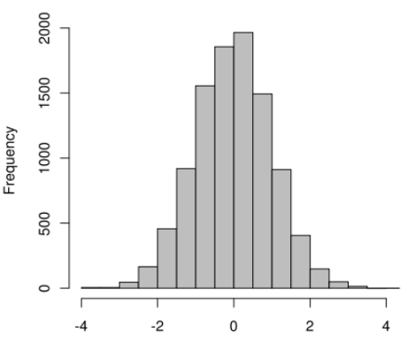
Range partitioning
Goal: equal frequency per machine
Note: ranges often don’t divide x axis evenly
How to choose?

Slide 55
Range partitioning
Goal: equal frequency per machine
Note: ranges often don’t divide x axis evenly
How to choose?
Would be easy if data small
In general, can sample the input relation prior to shuffling, pick splits based on sample
Note: Random sampling can be tricky to implement in a query pipeline; simpler if you materialize first.

Slide 56
Some Sorting Records
Sorting has become a blood sport!
Parallel sorting is the name of the game ...
Minute Sort: how many 100-byte records can you sort in a minute?
Current World record: 37 TB. Tencent.
512 nodes
2 10-core processors, 512 GB RAM, 4x1.2TB SSDs (2016)
CloudSort: min cost to sort 100TB
Current World record: $144. Alibaba+Databricks
394 Alibaba Cloud machines, 8GB RAM, 40GB Ultra Cloud Disks, 4 135GB SSD Cloud Disks (2016)
Also JouleSort and GraySort
See http://sortbenchmark.org
Berkeley students and alumni have held sorting trophies at various times
Always evolving
This slide is FYI; will not be on exams

Slide 57
Parallel Sort-Merge Join
Pass 0 .. n-1 are like parallel sorting above
R
range
R
R
Note: this picture is a 2-pass sort (n=1); this is pass 0

Slide 58
Parallel Sort-Merge Join
Pass 0 .. n-1 are like parallel sorting above
But do it 2x: once for each relation, with same ranges
R
range
S
R
S
R
S
Note: this picture is a 2-pass sort (n=1); this is pass 0

Slide 59
Pass n (with optimization)
Pass 0 .. n-1 are like parallel sorting above
But do it 2x: once for each relation, with same ranges
Pass n: merge join partitions locally on each node
R
R ⨝ S
S
R
R ⨝ S
S
R
R ⨝ S
S

Slide 60
Pass 0 .. n-1 are like parallel sorting above
But do it 2x: once for each relation, with same ranges
Pass n: merge join partitions locally on each node
R
R ⨝ S
S
R
R ⨝ S
S
R
R ⨝ S
S

Slide 61
Quick Check
T/F: In parallel sorting…
The main change over single-node is the range-based shuffle at the beginning
The first pass can do parallel scans
Each node waits to consume the shuffle input before forming partitions
Multiple merge passes can be handled exactly as in single-node sorting
T/F: In parallel sort-merge join…
The main change over single-node is the range-based shuffle in the final phase
Two tuples that need to join always end up at the same machine
If one key is quite popular, the range partitioning will adjust to balance load

Slide 62
Intra-Operator Parallelism iI
Group By/Aggregate

Slide 63
Parallel Aggregates/GroupBy
Hierarchical aggregation
For each aggregate function, need a global/local decomposition:
sum(S) = Σ Σ (s)
count = Σ count (s)
avg(S) = (Σ Σ (s)) / Σ count (s)
etc...
SELECT SUM(sales) FROM all_sales
Σ
Σ
Σ
Σ
Advanced topic: can you think of a summary statistic this doesn’t work for?
Notes:
88

Slide 64
Parallel Aggregates/GroupBy
Hierarchical aggregation
For each aggregate function, need a global/local decomposition:
sum(S) = Σ Σ (s)
count = Σ count (s)
avg(S) = (Σ Σ (s)) / Σ count (s)
etc...
Naïve Hash Group By
Local aggregation: in hash table keyed by group key k_{i} keep local agg_{i}
In example, k is dno, agg is (sum(sales), count(*))
Shuffle local aggs by a hash function h_{p}(k_{i})
Compute global aggs for each key k_{i}
SELECT dno, AVG(sales) FROM all_sales
GROUP BY dno
h_{p}
Notes:
88

Slide 65
Parallel Aggregates/GroupBy
Hierarchical aggregation
For each aggregate function, need a global/local decomposition:
sum(S) = Σ Σ (s)
count = Σ count (s)
avg(S) = (Σ Σ (s)) / Σ count (s)
etc...
Naïve Hash Group By
Local aggregation: in hash table keyed by group key k_{i} keep local agg_{i}
In example, k is dno, agg is (sum(sales), count(*))
Shuffle local aggs by a hash function h_{p}(k_{i})
Compute global aggs for each key k_{i}
Exercise:
Figure out GraceHash-based scheme to handle large # of groups
Figure out Sort-based scheme
SELECT dno, AVG(sales) FROM all_sales
GROUP BY dno
h_{p}
Notes:
88

Slide 66
Quick Check
Which of the following are true:
For a single group (i.e. no GROUP BY), there is no use for hierarchical aggregation
For GROUP BY, all local aggregates for a given group need to be shuffled to the same machine
To do GROUP BY in a single pass on N rows
You need enough memory (across all machines) to hold all N rows
You need enough memory to hold (k_{i}, agg_{i}) for all distinct group values k_{i}
You need O(sqrt(N)) memory across all machines

Slide 67
PARTITIONING OPTIONS FOR JOIN: BIGGER PICTURE

Slide 68
Joins: Bigger picture
alternatives:
symmetric shuffle
what we did so far
asymmetric shuffle
broadcast join

Slide 69
Join: asymmetric shuffle
If R already suitably partitioned,
just partition S, then run local join at every node and union results.
R
S
R ⨝ S
R
S
R ⨝ S
R
S
R ⨝ S

Slide 70
“Broadcast” Join
If R is small, send it to all nodes that have a partition of S.
Do a local join at each node (using any algorithm) and union results.
input R
input S

Slide 71
Quick Check
Broadcast Join is useful when one relation is
Very small
Large, but highly skewed
Partitioned on the join key
Asymmetric shuffle is useful when one relation is:
Very small
Large but highly skewed
Partitioned on the join key

Slide 72
Back to Pipeline parallelism

Slide 73
What are “pipeline breakers”?
Sort
Hence sort-merge join can’t start merging until sort is complete
Hash build
Hence Grace hash join can’t start probing until hashtable is built
Is there a join scheme that pipelines?

Slide 74
Symmetric (Pipeline) Hash Join
Prisma/DB
Univ. Twente
1990
Single-phase, streaming
Each node allocates two hash tables, one for each side
Upon arrival of a tuple of R:
Build into R hashtable by join key
Probe into S hashtable for matches and output any that are found
Upon arrival of a tuple of S:
Symmetric to R!
Why does it work?
Each output tuple is generated exactly once: when the second part arrives
Streaming: can always pull another tuple from R or S, build, and probe for outputs
Useful for Stream query engines!
R
S

Slide 75
Extensions
R
h_{n}
Parallel Symmetric Hash Join
Straightforward—part of the original proposal
Just add a streaming partitioning phase up front as in naïve hash join
Out-of-core Symmetric Hash Join
Quite a bit trickier. See the X-Join paper.
Non-blocking sort-merge join
See the Progressive Merge Join paper
S
R
S
R
S

Slide 76
Encapsulating parallelism: Exchange
This section is FYI; will not be on exams

Slide 77
A Software Engineering Query
How can I take my single-threaded iterator system and add parallelism?
Idea: encapsulate parallel dataflow as an iterator itself: Exchange.
An innovation of the Volcano system

Slide 78
Exchange as Metaphor
“Logical” Plan
To get from here:
To here:
⨝
Scan R
Scan S
⨝
⨝
⨝
Scan R
Scan S
Scan R
Scan S
Scan R
Scan S
Partition Parallelism

Slide 79
Interpose Exchange Operators
Rewrite like this
Everything stays the same, but eXchange is hiding two main things:
Shuffling tuples across multiple machines, dealing with networking
The fact that sender and receiver need to be in separate threads
Otherwise receiver can stall waiting for local children
⨝
X
X
Scan R
Scan S

Slide 80
Exchange is Two Iterators
Rewrite like this
X-out runs as its own thread
Along with its subtree
Separate from X-in and its parents
X-out pulls from its children and pushes to X-in
X-in stalls until it receives tuples from X-out
Network queues at X-out and X-in can buffer a few tuples
All other iterators behave as they always did in a single-node setting
⨝
X-in
X-in
THREAD BOUNDARY
X-out
X-out
Scan R
Scan S

Slide 81
Exchange is Two Iterators
Now run this at each machine and have X-out shuffle its output across X-ins on all machines
⨝
X-in
X-in
X-out
X-out
Scan R
Scan S

Slide 82
Exchange is Two Iterators
Now run this at each machine and have X-out shuffle its output across X-ins on all machines
⨝
X-in
X-in
X-out
X-out
Scan R
Scan S
⨝
⨝
⨝
X-in
X-in
X-in
X-in
X-in
X-in
X-out
X-out
X-out
X-out
X-out
X-out
Scan R
Scan S
Scan R
Scan S
Scan R
Scan S

Slide 83
Parallel DBMS Summary
Parallelism natural to query processing:
Both pipeline and partition
Shared-Nothing vs. Shared-Mem vs. Shared Disk
Shared-mem easiest SW, costliest HW.
Doesn’t scale.
Shared-nothing cheap, scales well, harder to implement.
Shared disk a middle ground
Introduces icky stuff related to concurrency control
Intra-op, Inter-op, & Inter-query parallelism all possible.

Slide 84
Parallel DBMS Summary, cont.
Data layout choices important!
Most DB operations can be done partition-parallel
Sort.
Sort-merge join, hash-join.
Complex plans.
Allow for pipeline-parallelism, but sorts, hashes block the pipeline.
Partition parallelism achieved via bushy trees.

Slide 85
Parallel DBMS Summary, cont.
Transactions actually pretty easy
distributed deadlock detection
two-phase commit
2PC not great for availability, latency
single failure stalls the whole system
transaction commit waits for the slowest worker

